Slide 1





Slide 2


CONVENTION 4-DAY FORECAST
THUR 7/25
FRI 7/26
SAT 7/27
SUN 7/28
REGISTRATION
LEADERSHIP MEETING
CHAMPAGNE FOR THE CAMPAIGN
REGISTRATION
WORKSHOP
GENERAL
SESSION 1 & 2
GENERAL SESSION 3
CEO BREAKOUTS
Mostly
SUNNY
Morning
thunderstorms
Possible
thunderstorms
Possible
thunderstorms
93º / 74º
93º / 75º
95º / 77º
95º / 77º

Slide 3

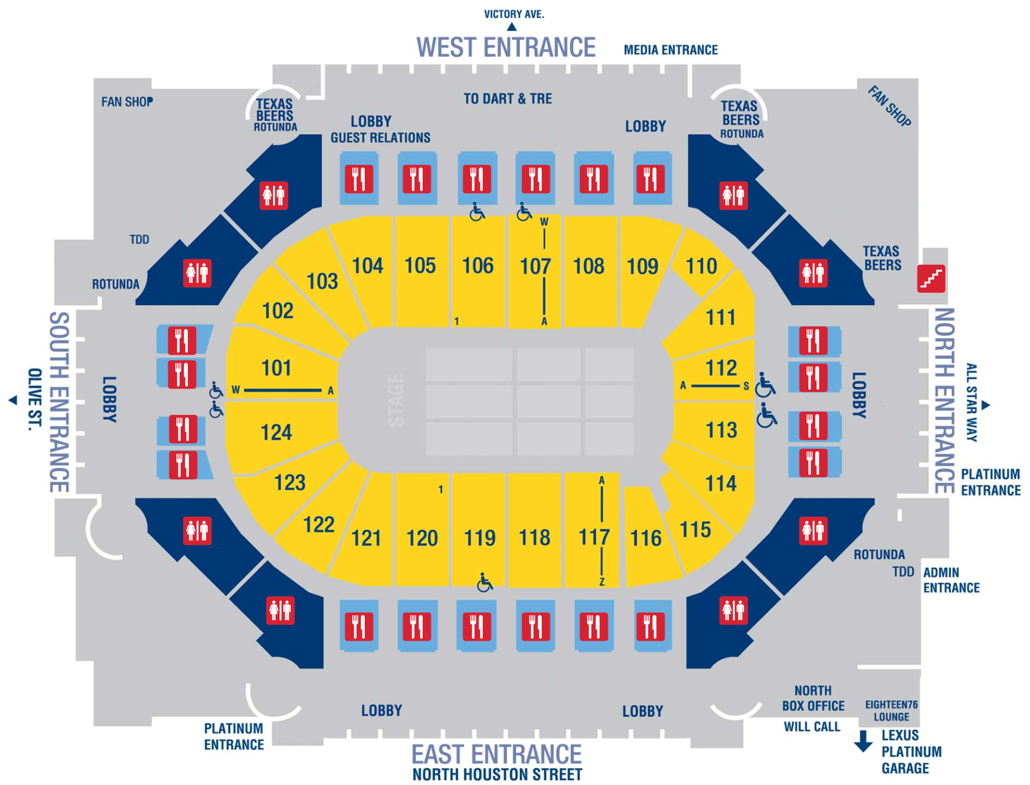
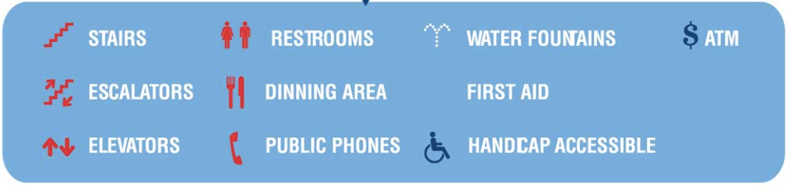
REGISTRATION
IN VICTORY PARK
OLIVE STREET

Slide 4


GUIDELINES
American Airlines Center (AAC) Security Guidelines
Guests are asked to cooperate with security personnel to ensure everyone's safety.
NO Food or beverage, including snacks of any kind
NO Refillable Bottles
NO Backpacks/Bags larger than 14" x 14" x 6"
NO Weapons of any kind
NO Professional camera equipment or photography lenses over 6" in length
NO Noisemakers (cowbells, whistles, horns)
NO Laser Pointers
Allowed | Not Allowed | ITEMs
 | X | Professional Cameras
X |  | Small Cameras
 | X | Audio/Video Recording
X |  | Flowers/Gifts (send to Guest Relations) (unwrapped)
 | X | Food/Beverage (seek supervisor for inquiries)
X |  | Flags/Posters(no profanity, as big as 1 person can hold, no sticks)
 | X | Banners
X |  | E Cigarettes (guests may bring them in, no vaping)
 | X | Selfie Sticks
 | X | Noise Makers (cowbells, whistles, horns)
 | X | Backpacks (smaller than 14” x 14” are acceptable)
 | X | Umbrellas (Umbrellas 12” or smaller when collapsed are acceptable, No POINTED umbrellas regardless of length)
LUGGAGE DROP: We recommend you drop off your luggage in your hotel room before going to the meeting. If you must bring your luggage to the American Airlines Center, there will be a complimentary Luggage Drop available at the South Entrance. Any luggage left is at your own risk. WSB does not assume any liability for lost/stolen luggage.

Slide 5
GUIDELINES
VIDEO RECORDING
& LIVE STREAMING
IS PROHIBITED
DURING
CONVENTION

Slide 6
Allowed | Not Allowed | ITEMS
 | X | Professional Cameras
X |  | Small Cameras
 | X | Audio/Video Recording
X |  | Flowers/Gifts (send to Guest Relations) (unwrapped)
 | X | Food/Beverage (seek supervisor for inquiries)
X |  | Flags/Posters (no profanity, as big as 1 person can hold, no sticks)
 | X | Banners
X |  | E Cigarettes (guests may bring them in, no vaping)
 | X | Selfie Sticks
 | X | Noise Makers (cowbells, whistles, horns)
 | X | Backpacks (smaller than 14” x 14” are acceptable)
 | X | Umbrellas (Umbrellas 12” or smaller when collapsed are acceptable, No POINTED umbrellas regardless of length)
ADDITIONAL GUIDE ON G19 WEBPAGE

Slide 7
GENERAL INFO
LUGGAGE DROP: We recommend you drop off your luggage in your hotel room before going to the meeting.
  If you must bring your luggage to the American Airlines Center, there will be a complimentary Luggage Drop available at the South Entrance.
Any luggage left is at your own risk. WSB does not assume any liability for lost/stolen luggage.
REGISTRATION
IN VICTORY PARK
OLIVE STREET

Slide 8
GENERAL INFO
Children’s Policy (Workshop / General Sessions)
  If they need a seat, wristband is required
  AAC security will maintain policy
  Strollers to be checked into Guest Services booths on concourse level

Slide 9

GENERAL INFO
1 color wristband for all seating
  See seating chart for CEO sections
REGISTRATION
IN VICTORY PARK
Bring your Campaign Pin!
OLIVE STREET

Slide 10
GENERAL SCHEDULE
Thurs, 7/25:
  10am–1pm Leadership Mtg / C4C Registration
  1pm–7pm All Registration
  2pm–6pm Leadership Meeting (invite only)
  6pm–10pm Champagne for the Campaign (invite only)
Fri, 7/26:
  9am–3pm Workshop
  6pm–10pm Awards Ceremony
                Family encouraged to come

Slide 11
GENERAL SCHEDULE
Sat, 7/27:
  8am–6pm General Session 1 & 2 (w/ lunch break)
Sun, 7/28:
  8am–1pm General Session 3
                MD / SMD Parade (subject to change)
  1pm–5pm CEO Breakouts (confirm with your CEO)

Slide 12
  INFORMATION ON
  WORLDSYSTEMBUILDER.COM/G19

