Slide 1
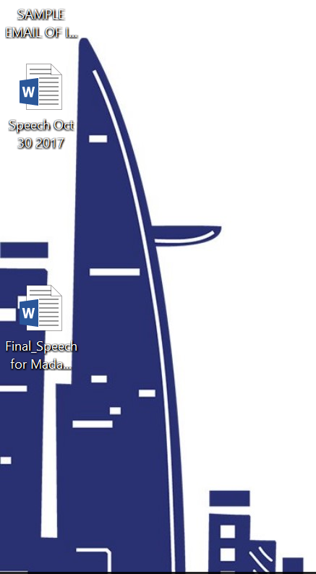

Slide 2


Slide 3
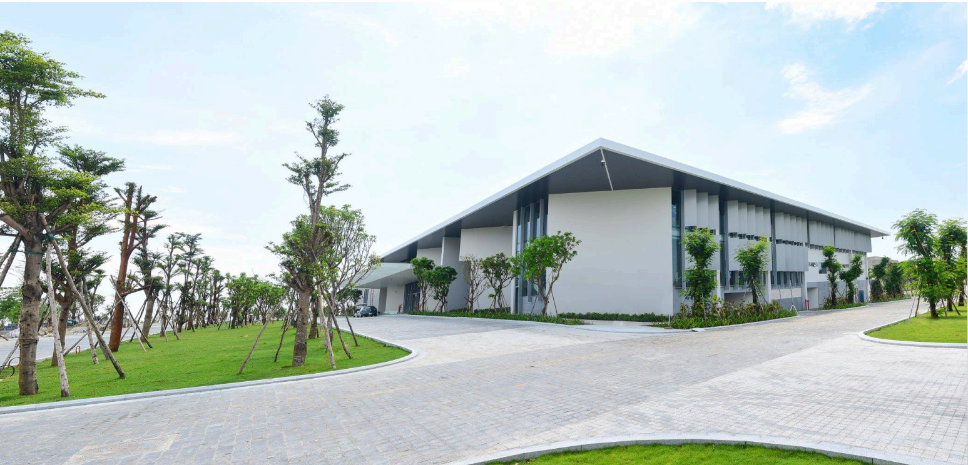

Slide 4
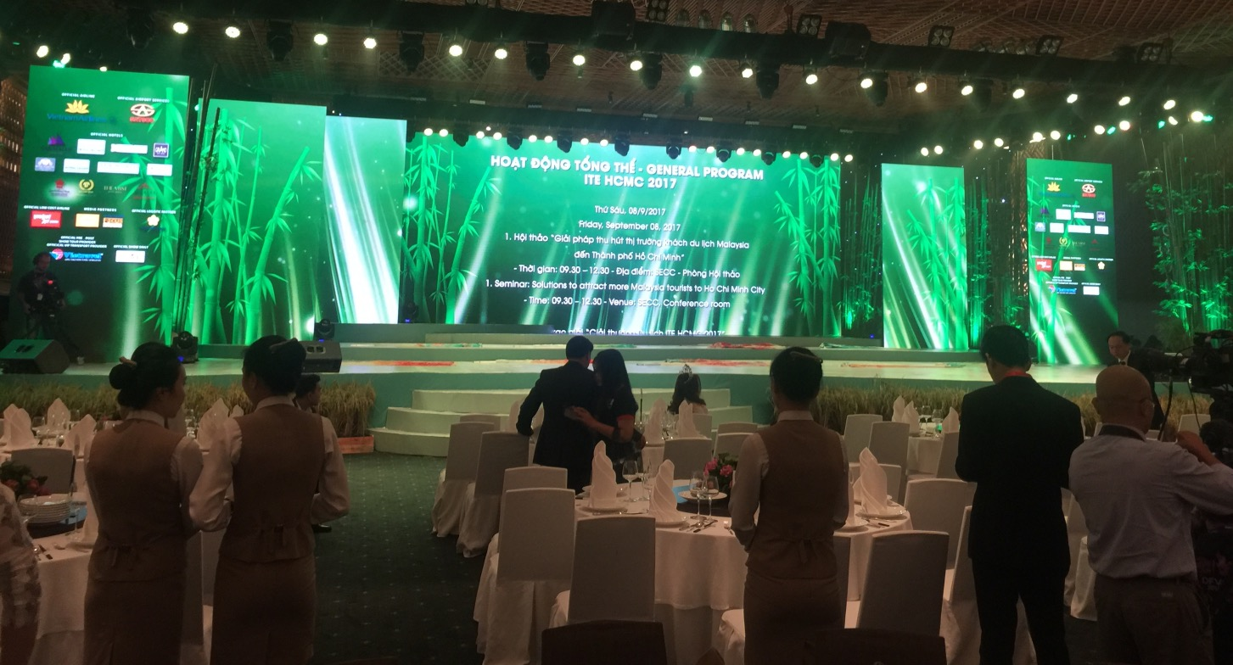

Slide 5
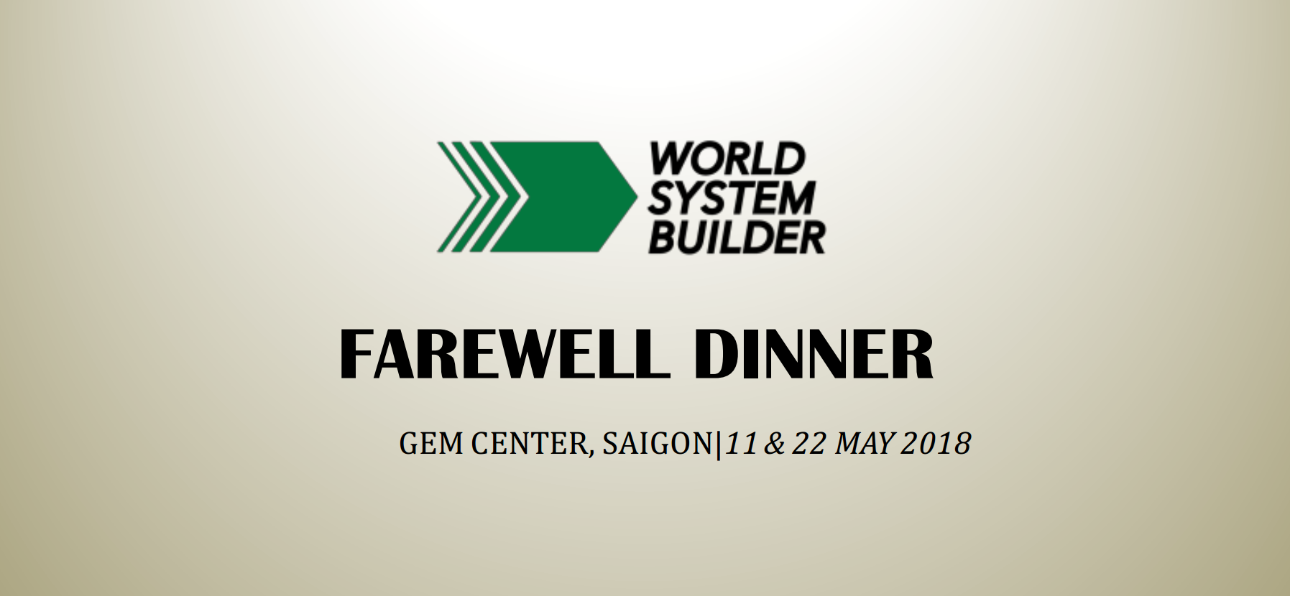

Slide 6
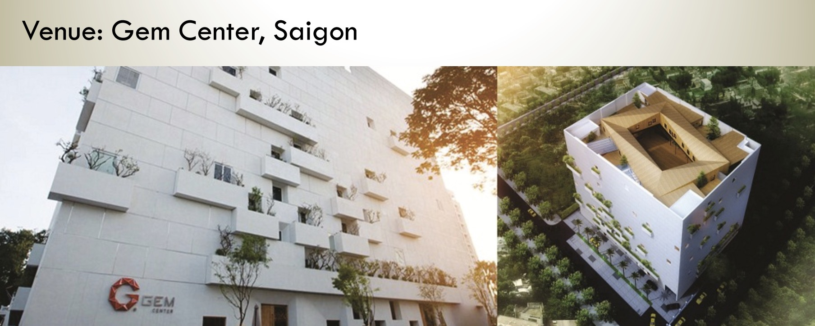

Slide 7
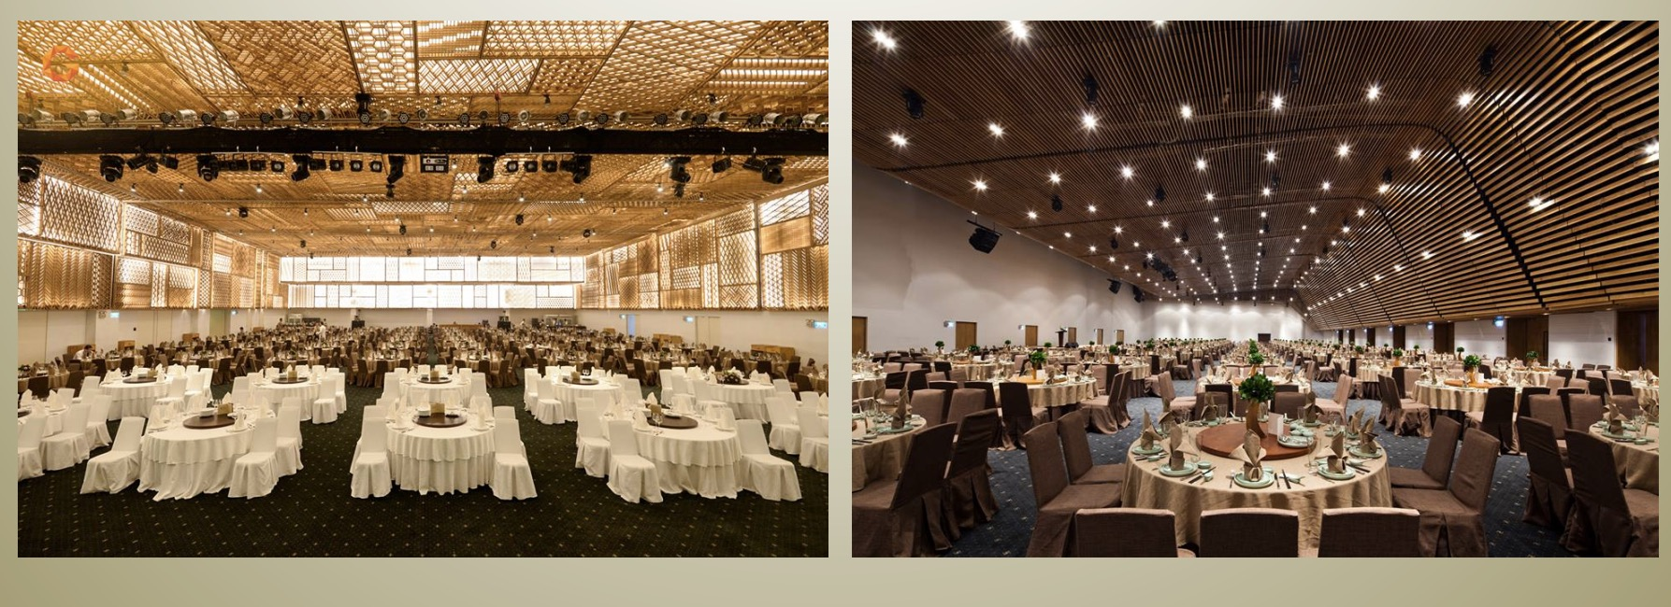

Slide 8
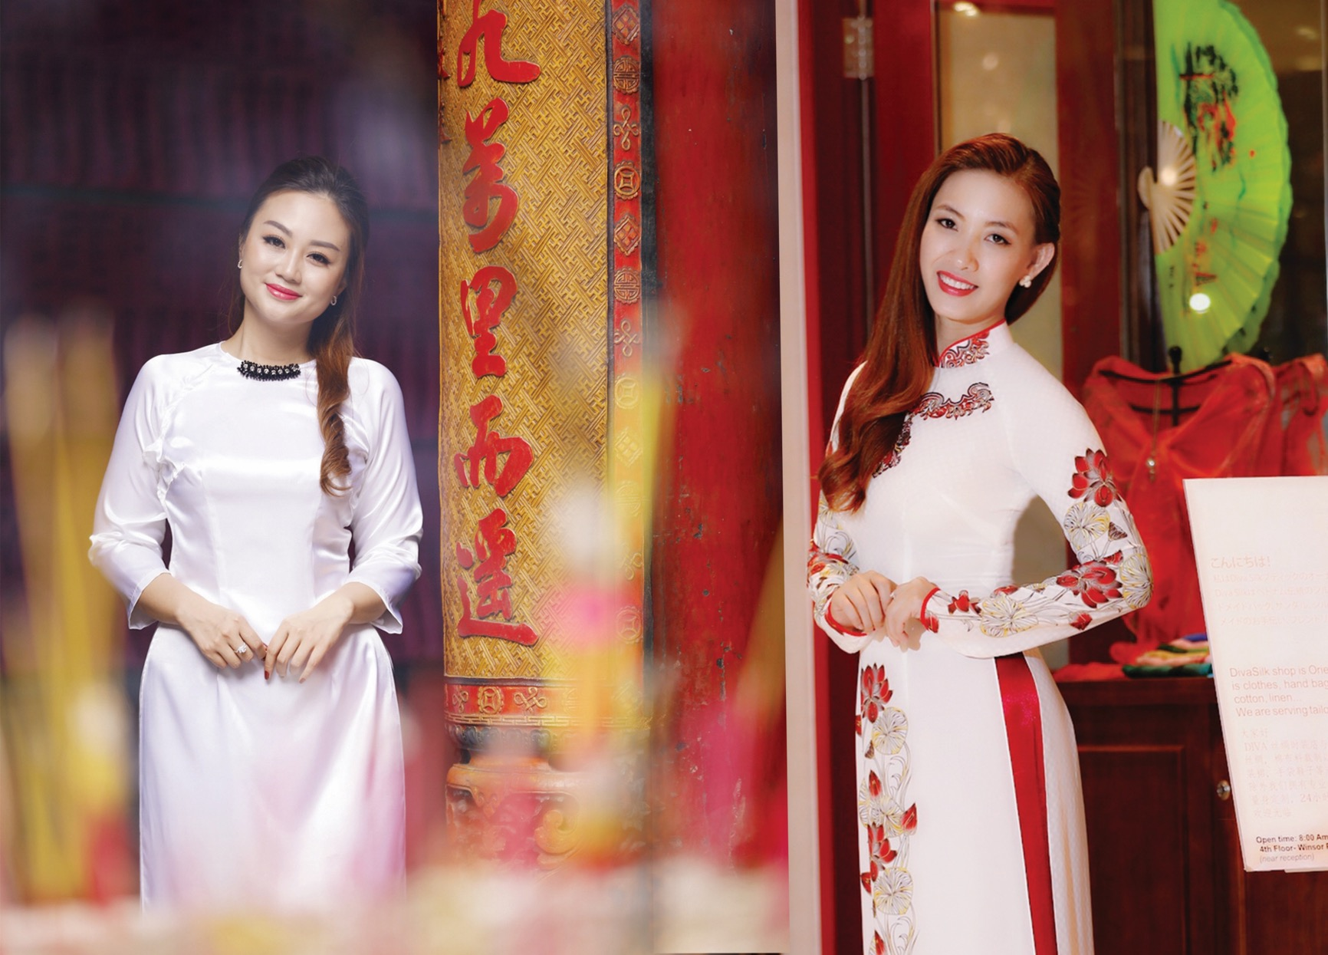

VIETNAMESE TRADITIONAL “AO DAI”

Slide 9
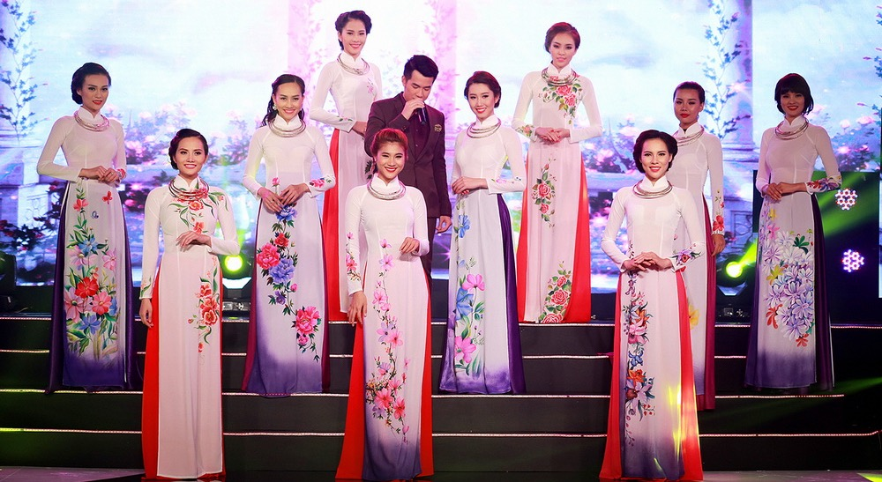
BE CHARM AND OUTSTANDING AT FAREWELL DINNER
We really encourage all of you to wear Ao Dai at the farewell dinner event so that you all can obtain remarkable and gorgeous group photos with your team members and leave unforgettable moments in Vietnam traditional costumes during the Vietnam Super trip.
Since we include many exciting traditional performances at the farewell dinner, so wearing Ao Dai dress will help expose more beauty of Vietnamese traditional culture and make you look more outstanding and charming.

Slide 10
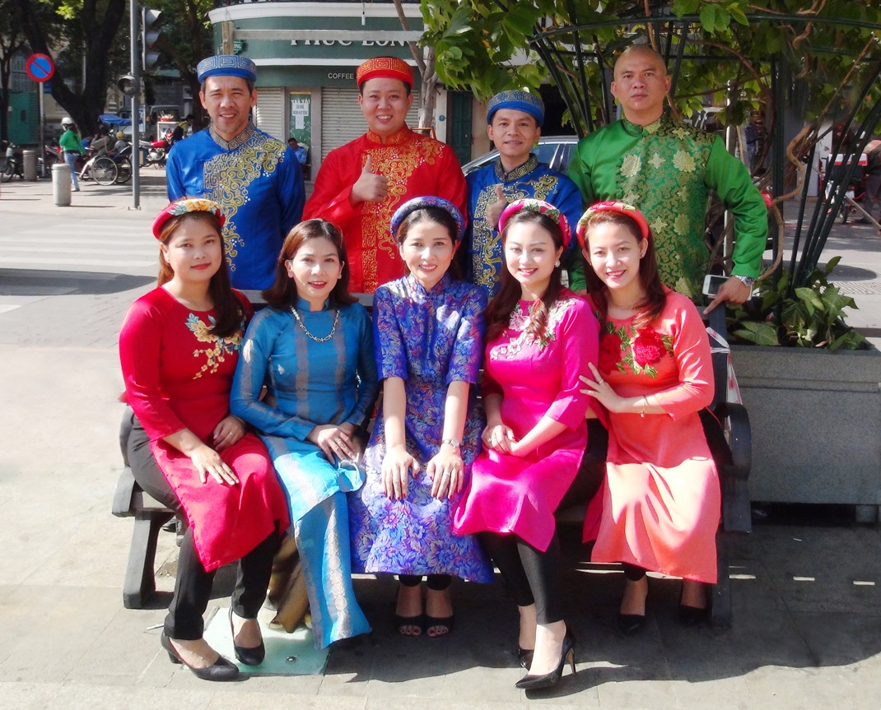
AO DAI TAILOR-MADE ORDER
Phu Bao are happy to provide this services as optional tours.
It can be registered and paid together in final payment or inquiry send through our email: wsb@phubaotours.com.vn

Slide 11
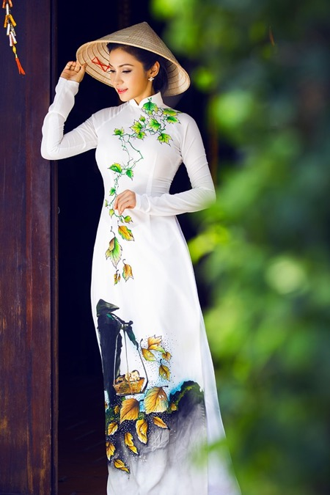
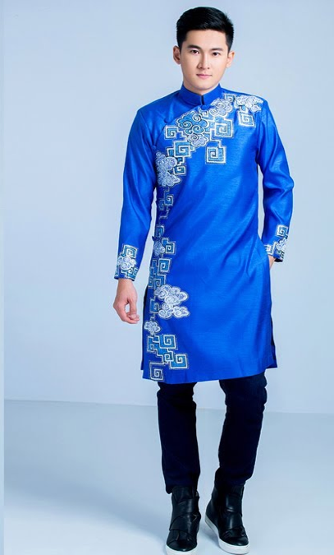
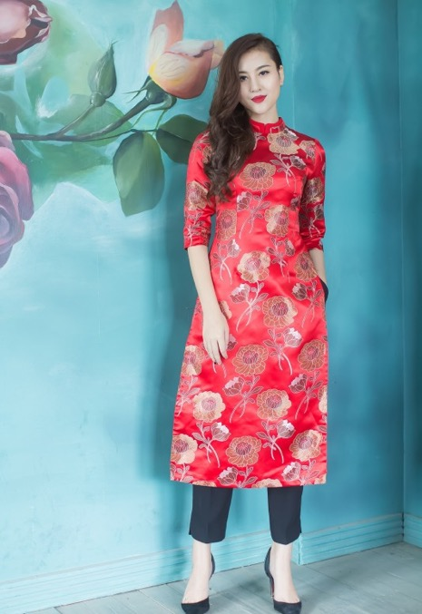
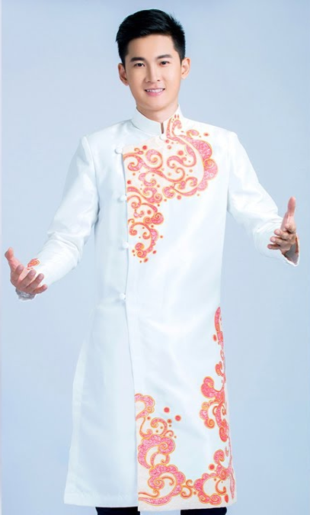
Traditional Ao Dai (Long Gown) For Woman: 50 USD/Set
Traditional Ao Dai For Man: 40 USD/ Ao dai (without trousers)
Áo dài cách tân: 40 USD/ Ao dai (without trousers)
AO DAI SAMPLES
For Women
Traditional (Long Gown, w/ pants): $50 USD / set
Áo dài cách tân (Short Gown, w/o pants): $40 USD / Ao dai
For Men
Traditional (w/o pants): $40 USD / set

Slide 12
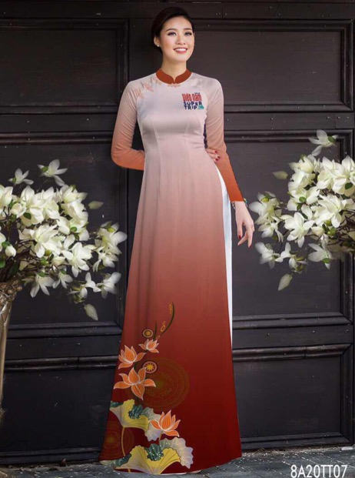
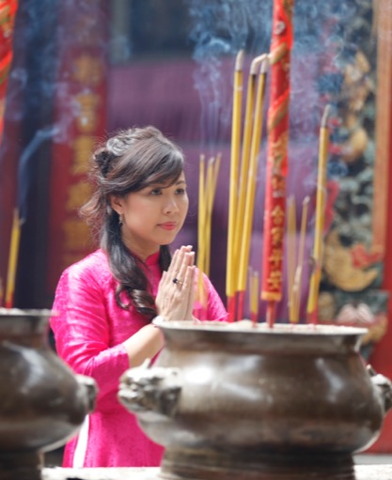
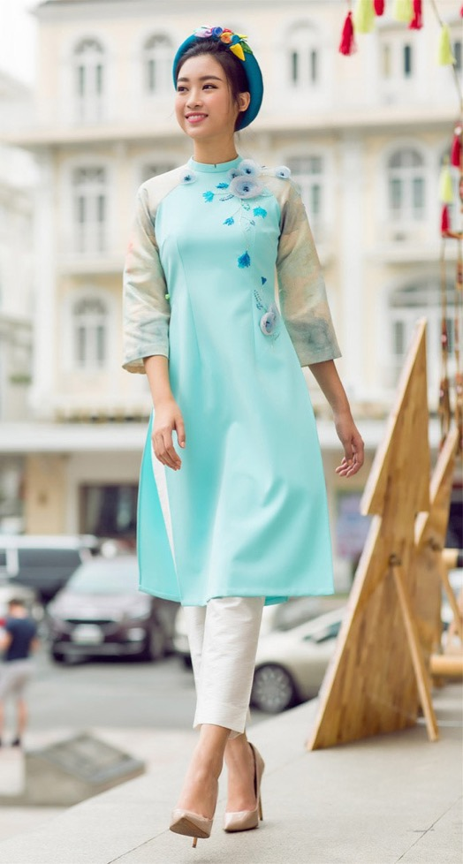
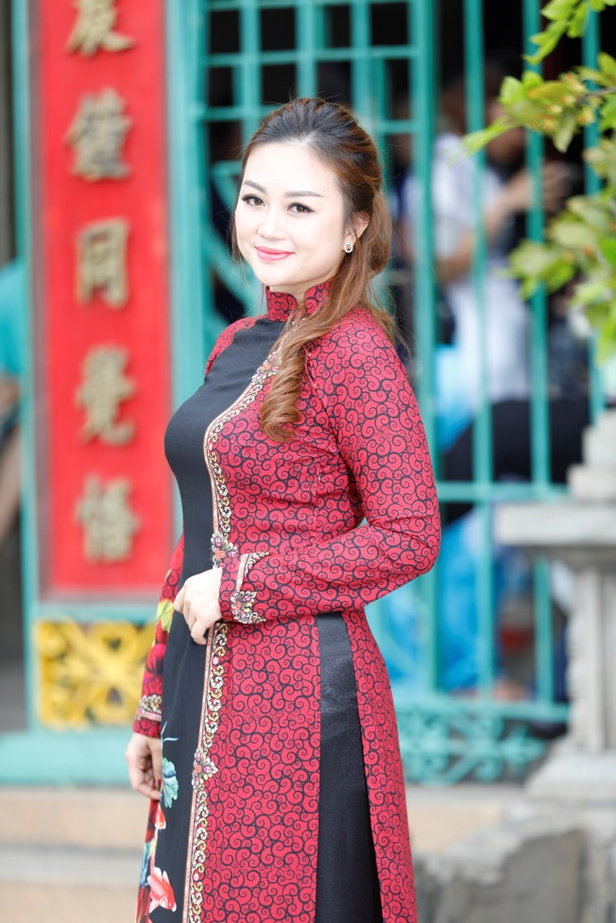
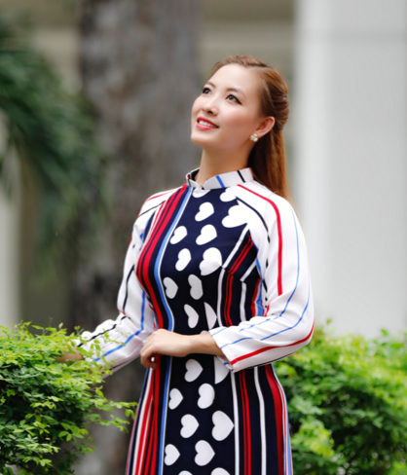
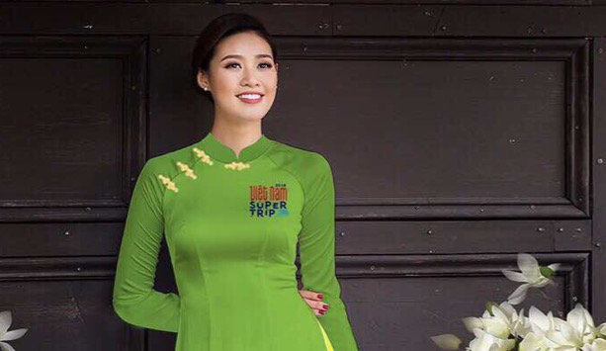
Traditional Ao Dai for Women

Slide 13
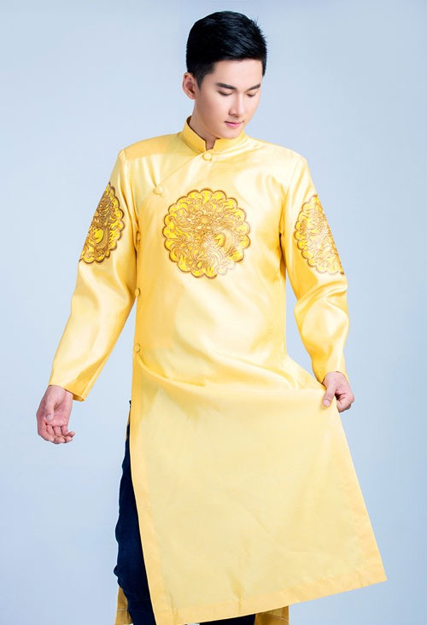
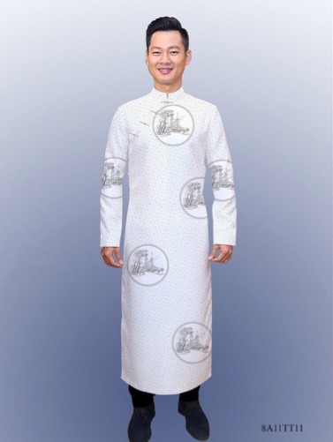
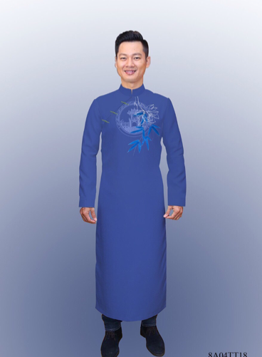
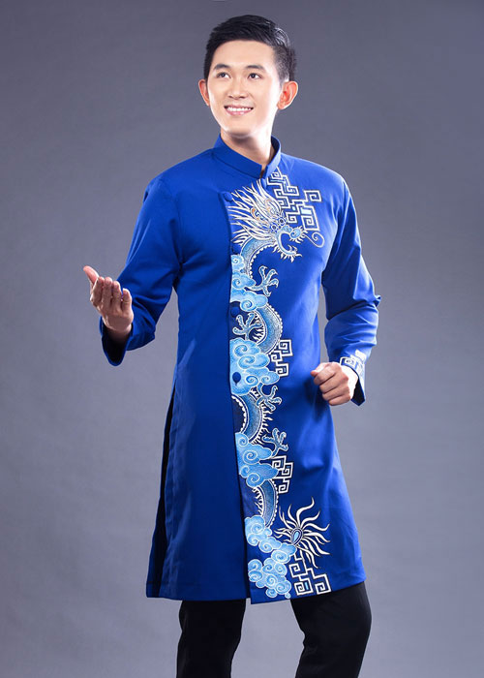
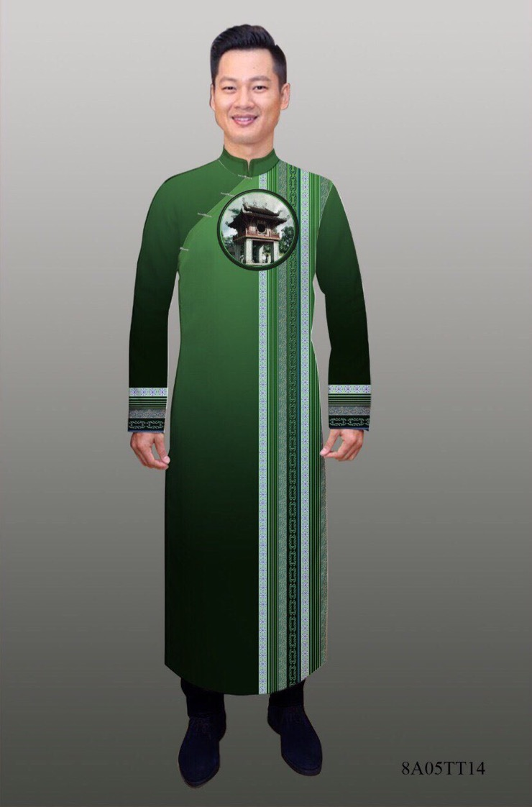
Traditional Ao Dai for Men

Slide 15
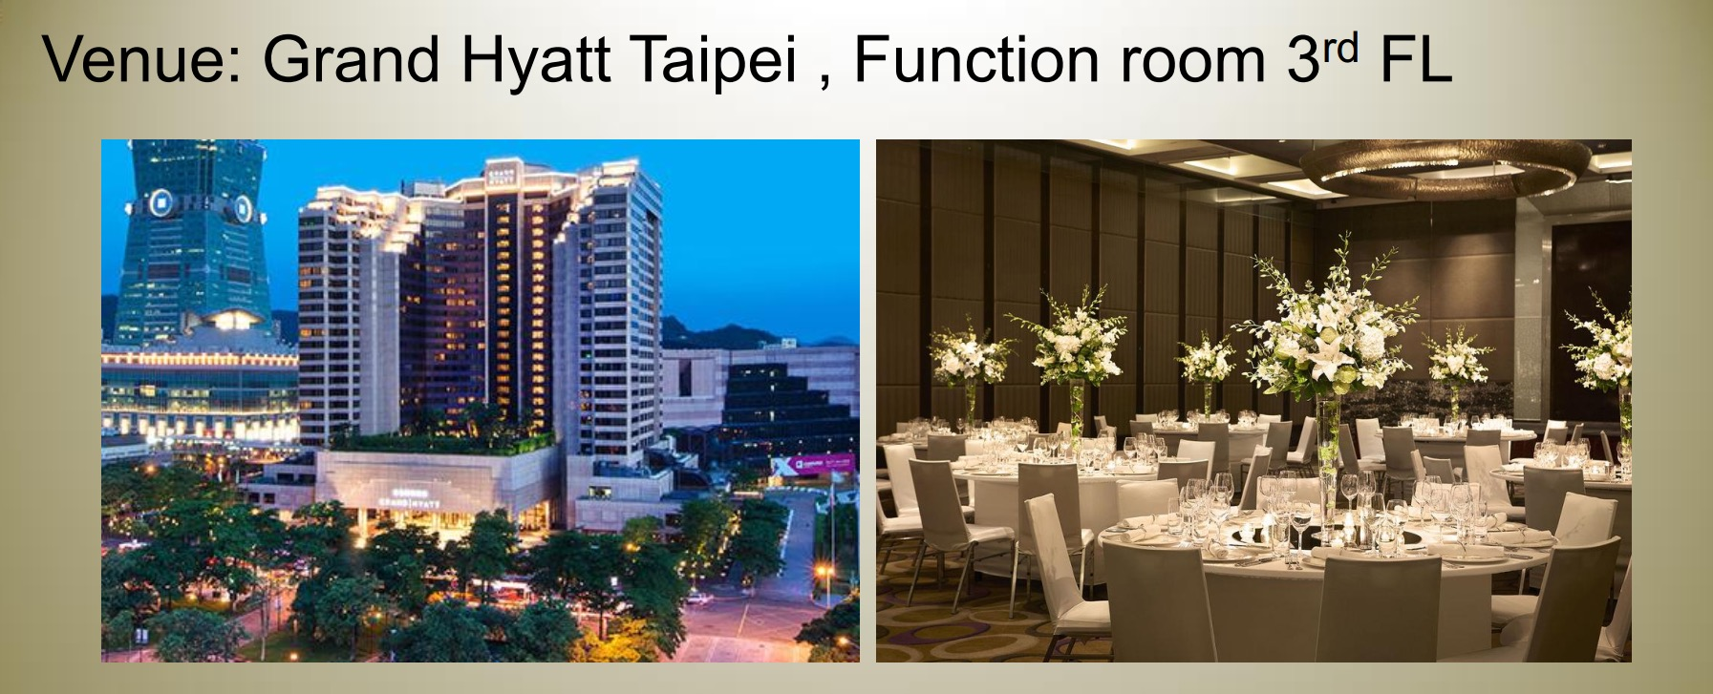

Slide 16
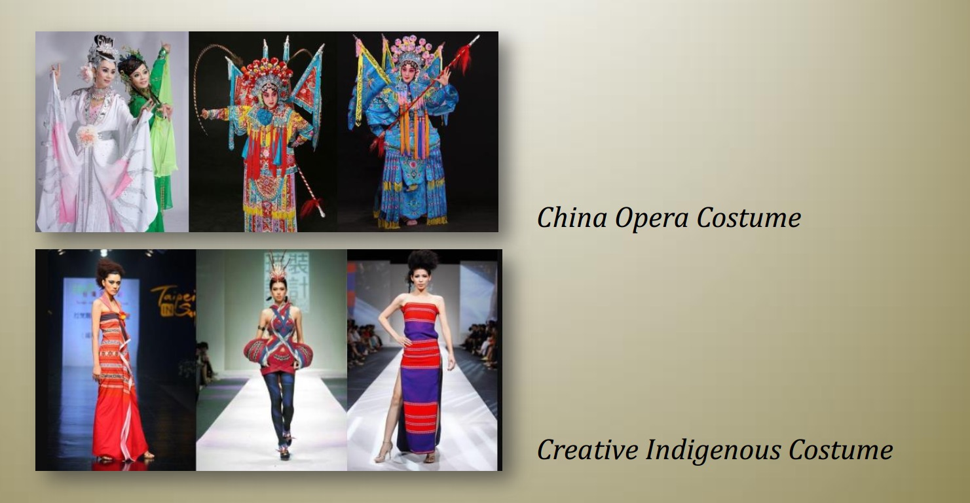

Slide 17
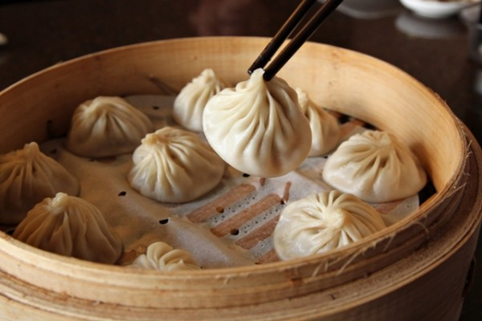
Xiao Long Bao (soup dumplings)
Some of the best in Taiwan

Slide 18
Milk Tea / Boba Tea / Bubble Tea
Originated in Taiwan

Slide 19
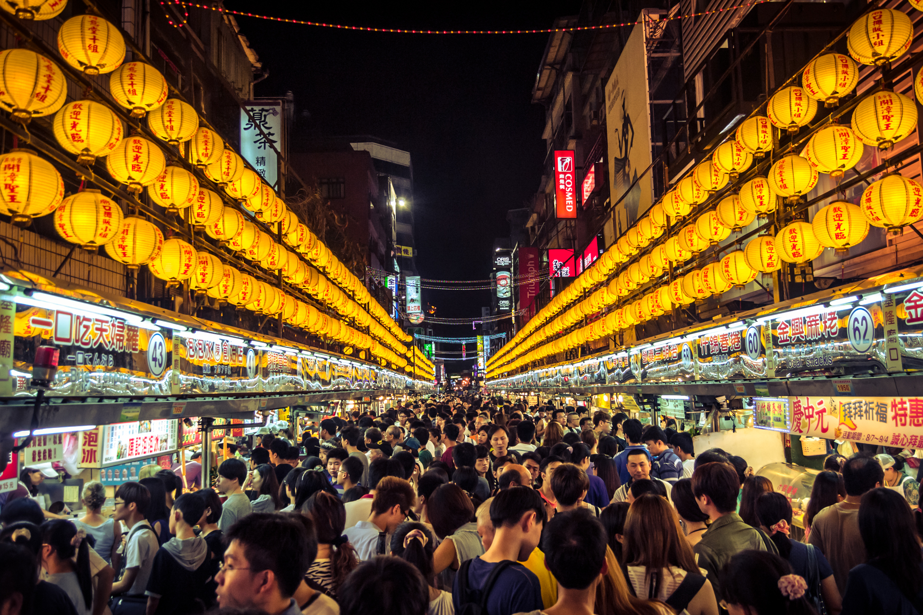
Night markets
Street food stretching for miles

Slide 20
