Slide 1


FOR INTERNAL USE ONLY.

Slide 2

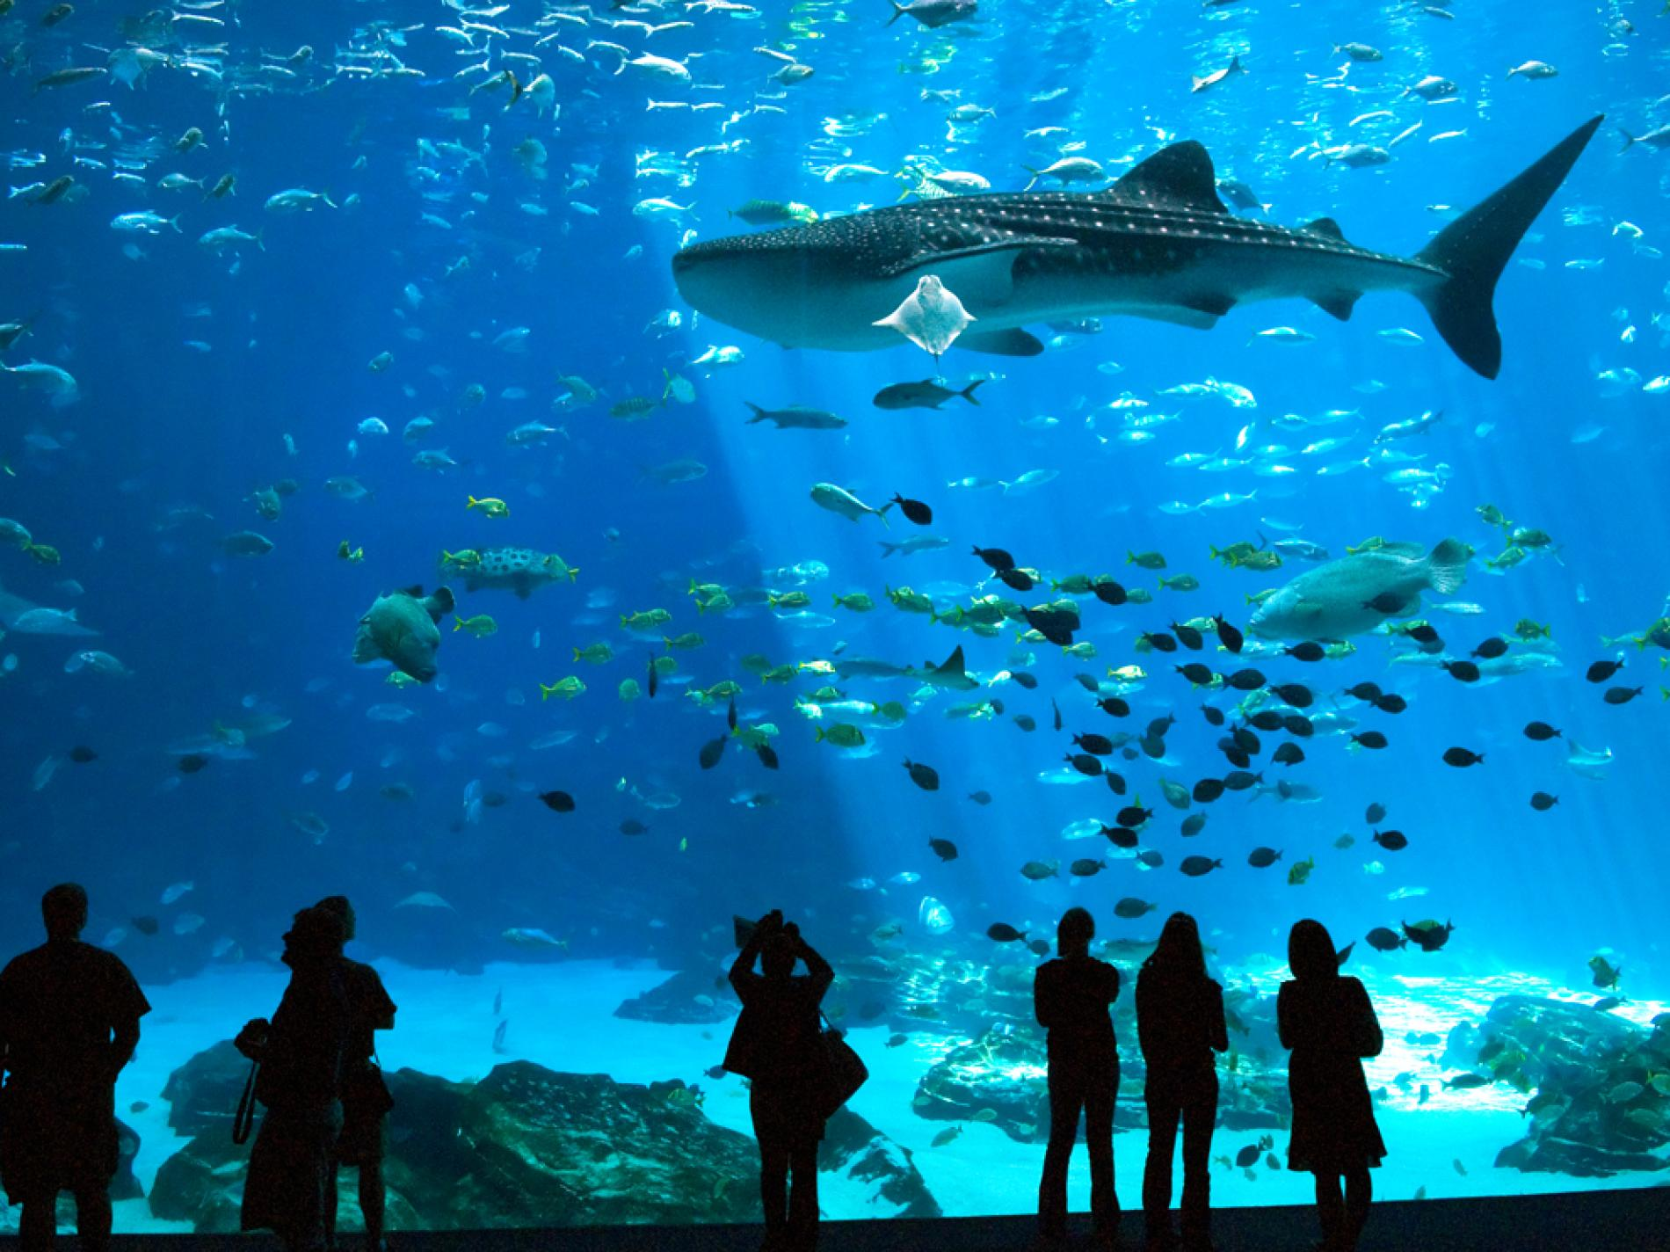

GEORGIA
AQUARIUM

Slide 3
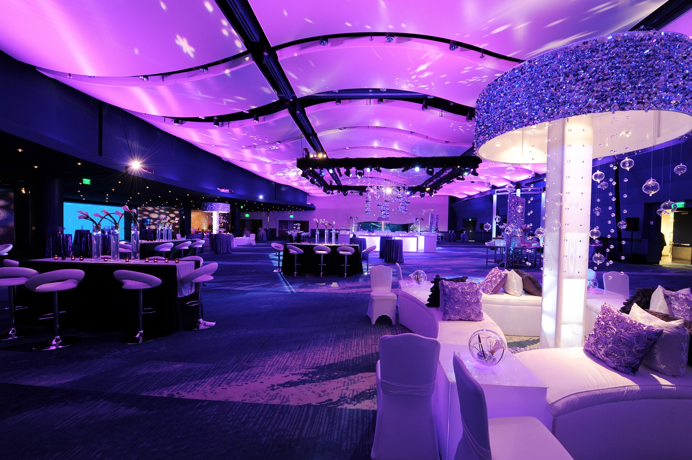

Slide 4
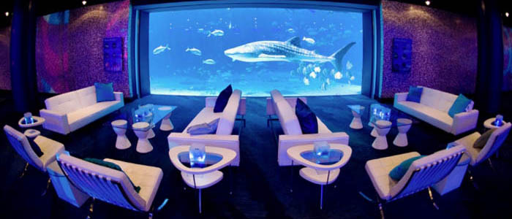

Slide 5
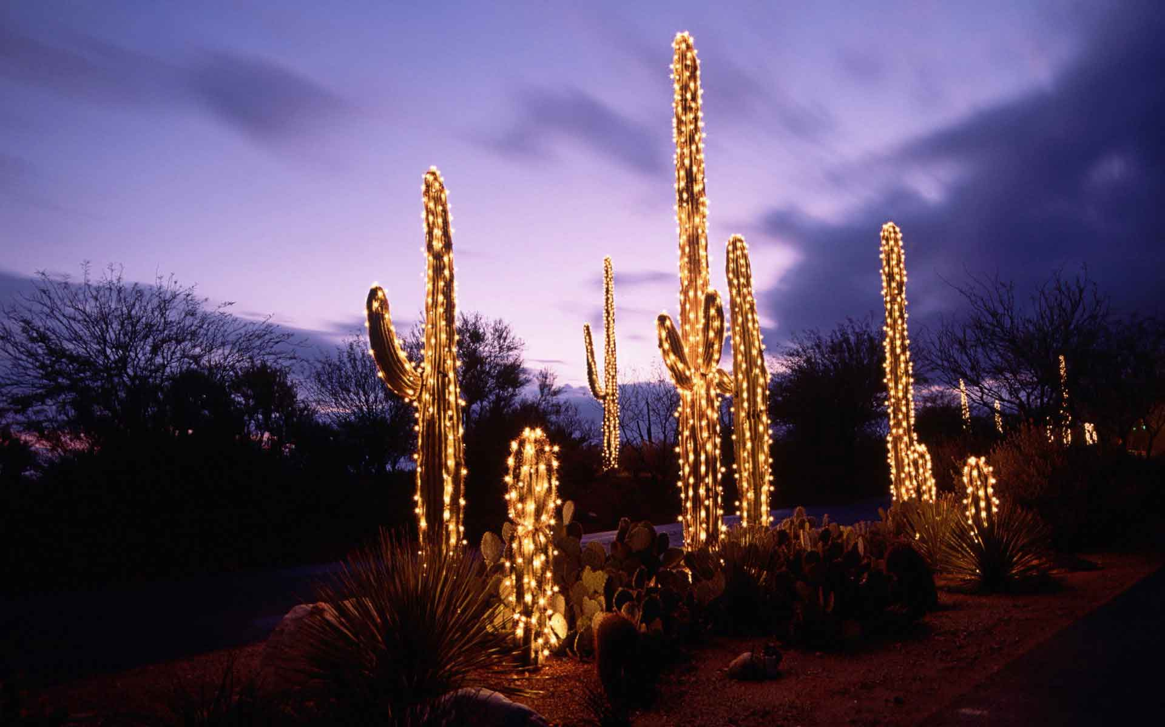


DESERT BOTANICAL GARDEN

Slide 6
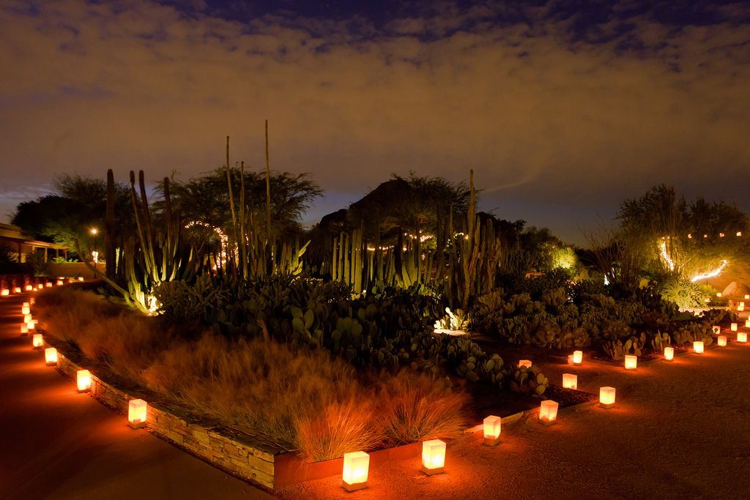

Slide 7
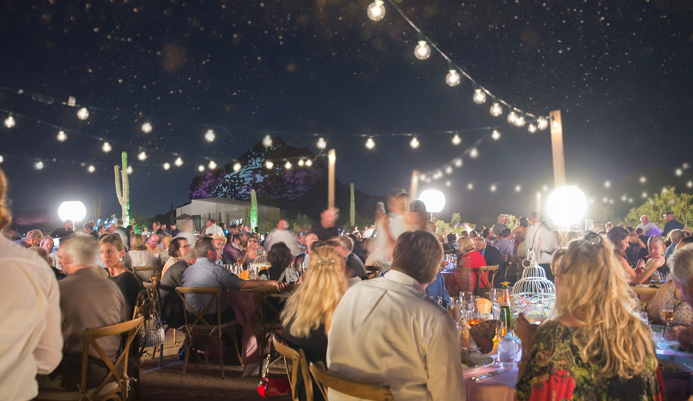

Slide 8
